Slide 1
Mini Update #5
By Brittany Huynh and Carlyn Mangana
05/04/2025

Slide 2
Date Insight
By Brittany Huynh
Type here

Slide 3
Date Insight
By Brittany Huynh
Type here

Slide 4
Data Insights
By Carlyn Mangana
Type here

Slide 5
Data Insights
By Carlyn Mangana
Type here

Slide 6
Progress
By Brittany Huynh and Car Mangana
This week, Car and Brittany answered the following curious questions:
Brittany didn’t face many major obstacles, but she struggled to come up with new questions to answer.
Car also didn't face any major obstacles, however, she struggled to do the estimation on her own as it’s a new skill she had just learned.
Carlyn and Brittany both contributed to the project this week. They filled out the spreadsheet and put their names on the slides that they covered in this update.
As for next week, the plan is to:
Start working on the Final Deliverable (Brainstorming, outlining, drafting, etc.)
Create the presentation or video

Slide 7
Feedback
By Carlyn Mangana
The feedback we received was really helpful in teaching us how to read our data better. We also were able to take the feedback we were told and generate better insights using the data we’ve already collected. With the new methods we’ve learned like permutation and estimation, we were able to learn new things about our data set. We’d love to hear what data we should reduce down in order to make our final project look more put together.

Slide 8
Mini Update #4
By Brittany Huynh and Carlyn Mangana
04/27/2025

Slide 9
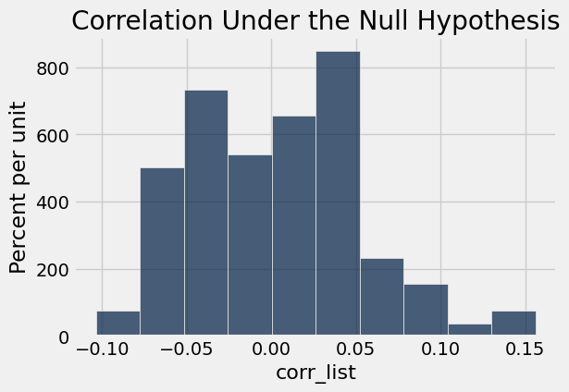
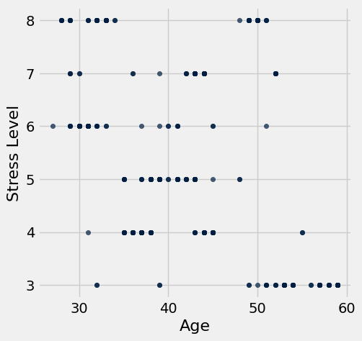
Permutation Test: Age vs. Stress Level
By Brittany Huynh
Observed correlation: -0.898752031004
p-value<0.001
-0.898752031004
Conclusion:
Layman’s version: there is strong evidence supporting the claim that older age is associated with lower stress level.
Scientific version: assuming null hypothesis that there is no relationship between age and stress level, the chance of seeing a difference at -0.899 or larger is less than 0.001. We reject the null hypothesis at a significance level of 0.001
H0: there is no association between Age and Stress Level
H1: Older age is associated with lower stress level and vice versa.

Slide 10
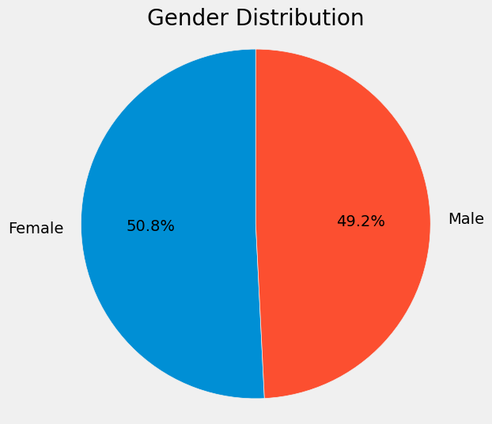
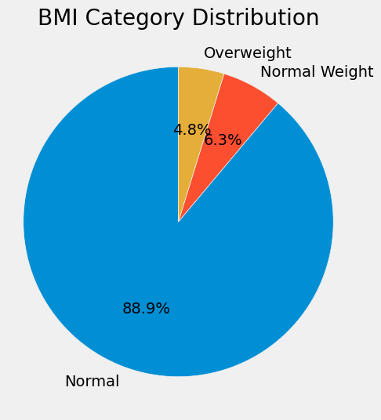
Exploring the Lifestyles of Engineers (The Least Stressed Occupation)
By Brittany Huynh
Gender | Quality of Sleep average | Age average | Stress Level average | Physical Activity Level average | Daily Steps average
Female | 9 | 52.7812 | 3 | 30 | 5000
Male | 7.80645 | 40.1935 | 4.80645 | 74.4194 | 6993.55
There are 63 total engineers in this dataset, with the gender makeup being nearly equal. From my previous insight, we find out that engineers are the occupation with the lowest stress level. Out of curiosity, I explored their lifestyle habits. I found that on average, female engineers are older, less stressed, and less physically active than male engineers. Overall, engineers live fairly healthy lifestyles, which explains their lower stress levels.

Slide 11

By Brittany Huynh
Average Female Engineer Data 🛠️
53 Years Old
9 out of 10 Sleep Quality Score 💤
3 out of 10 Stress Level Score 🧘🏻‍♀️
5000 Daily Steps 🏃🏻‍♀️
30 Physical Activity Level
Normal Weight (BMI 18.5-24.9)
https://iheartcraftythings.com/cartoon-woman-drawing.html
Link to source
Female engineers are one of the least stressed individuals in this dataset. They also live relatively healthy lifestyles with a high overall sleep quality score, a normal level of daily physical activity, and normal weight BMI category.

Slide 12
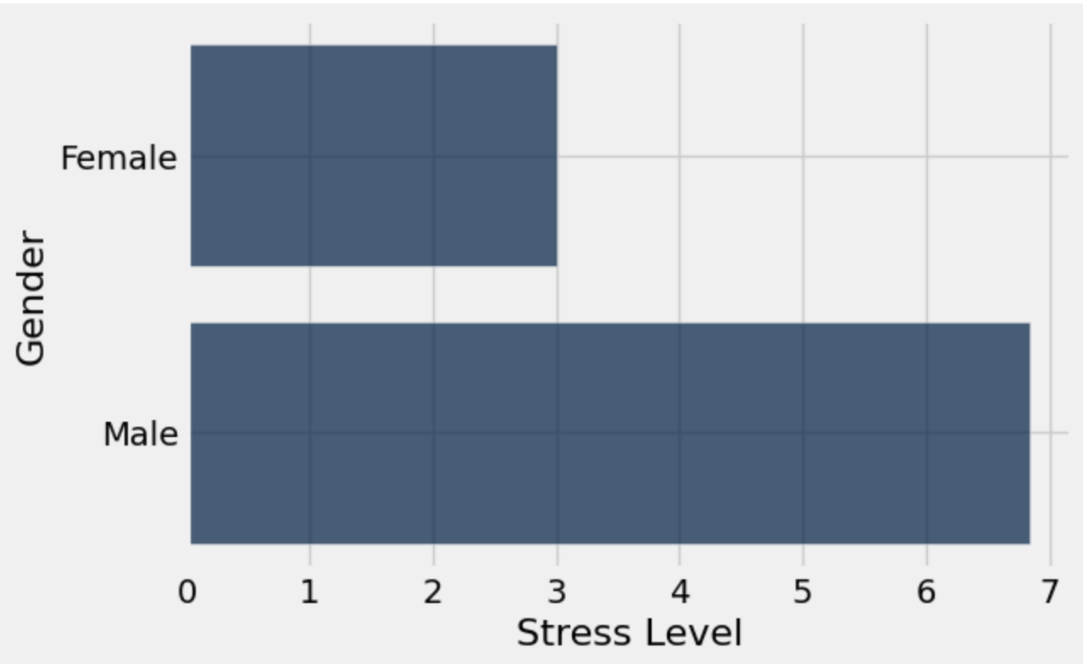
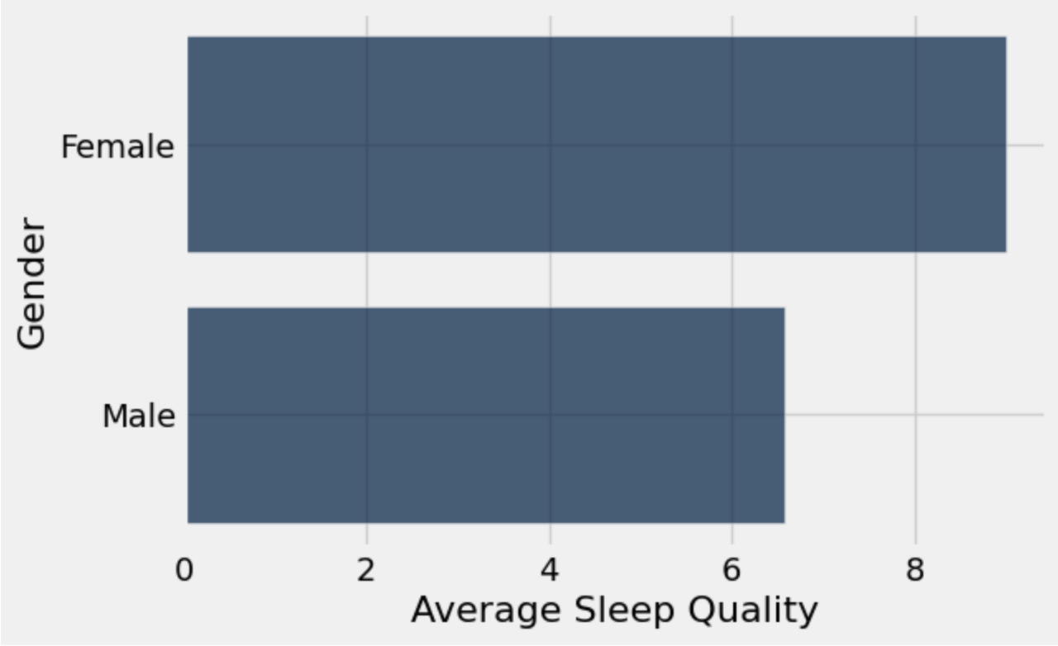
Data Insights
By Carlyn Mangana
Based off of previous feedback, I decided to separate my data from my curious question “Does Gender Impact the Doctor Lifestyle?” This made my data look a lot easier to read as well as made it clear that men face higher stress levels and poorer sleep quality compared to the women within the data.

Slide 13
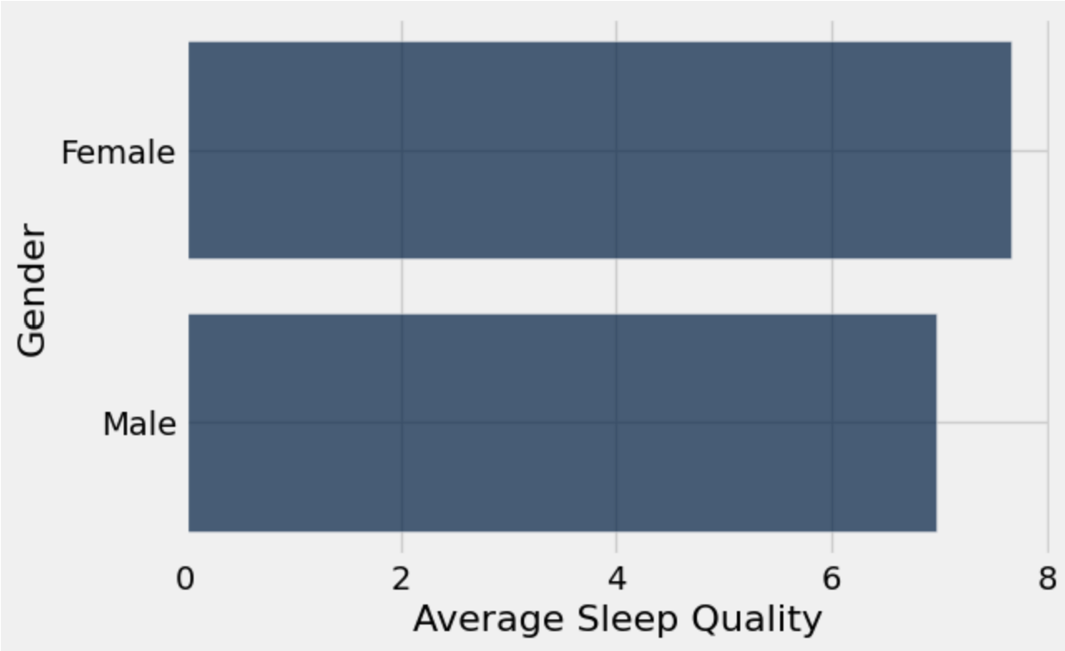
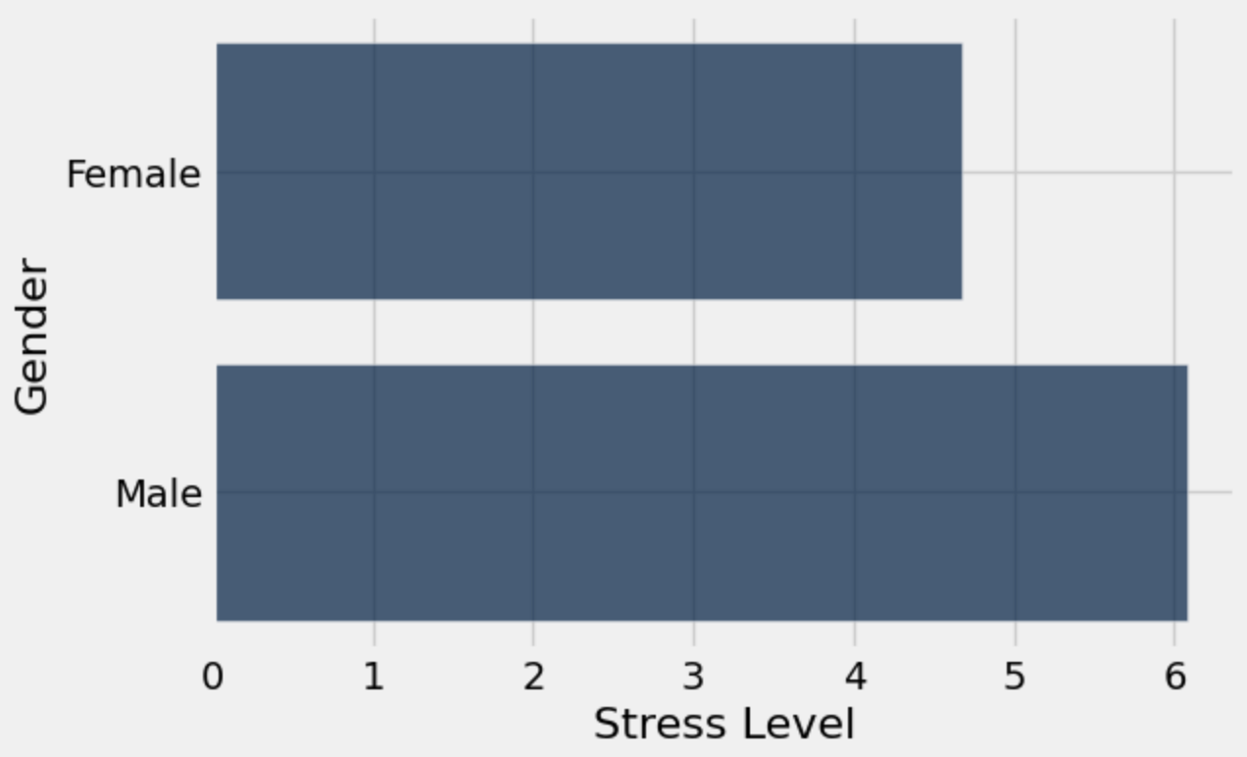
Data Insights
By Carlyn Mangana
Last week, after collection my data insights for this project, I came up with a new curious question, “Does Gender impact all Job Fields?” Based off of these two graphs, it seems that women face better sleep quality but also have lower stress levels. This could be because according to my previous research, women face gender disparities when it comes to career advancements, therefore, they have less opportunities to get these higher level careers.

Slide 14
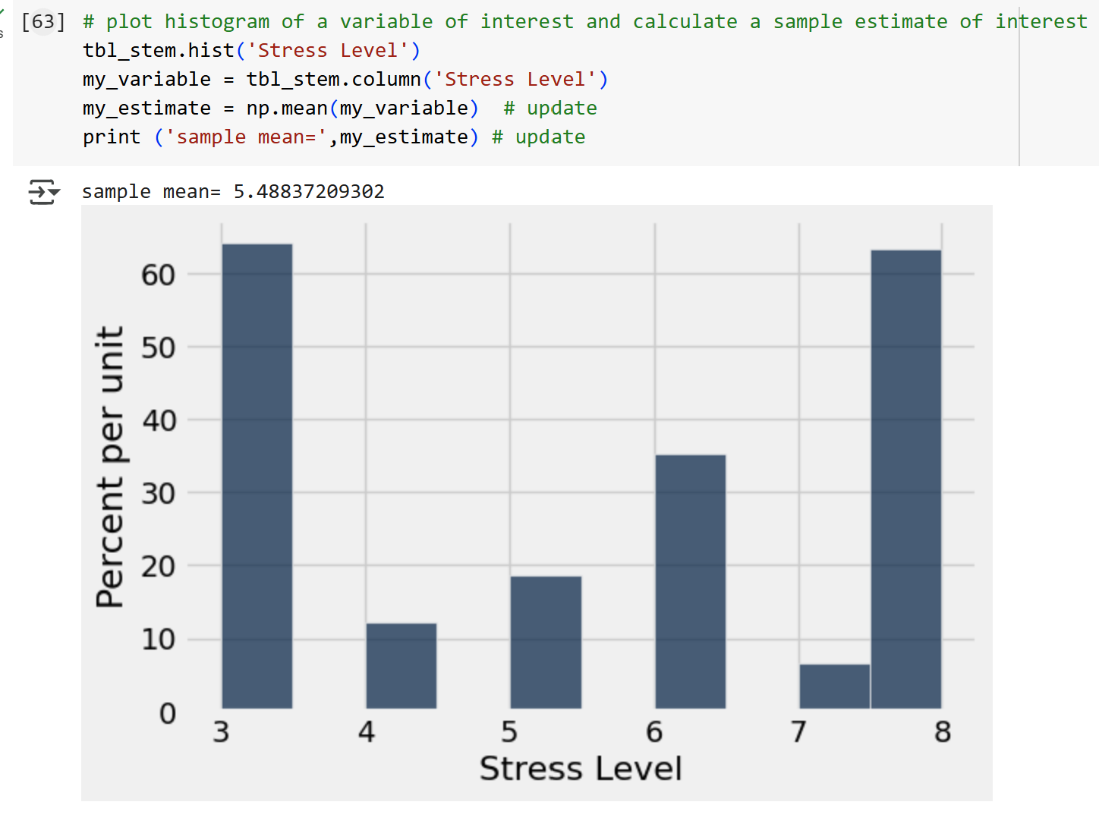
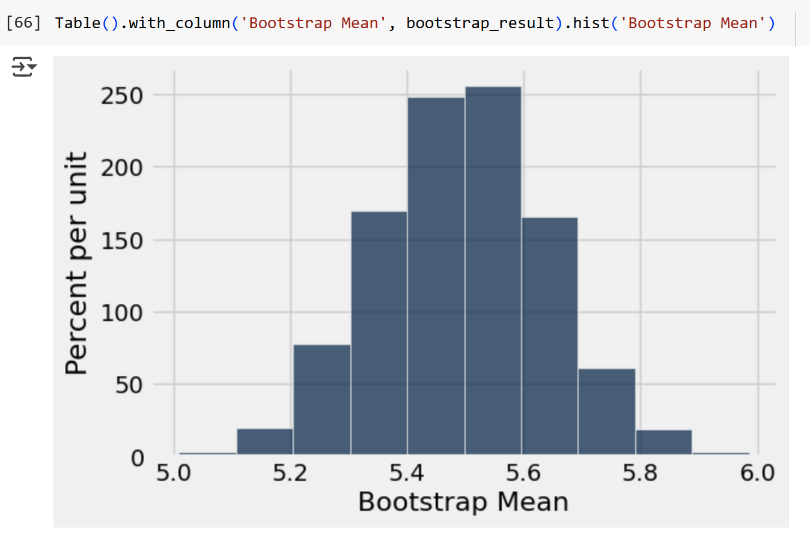
Estimation: STEM Stress Levels
By Carlyn Mangana
I am interested to know if STEM fields have high stress levels compared to Non-STEM
I plan to analyze Stress Levels which describe the average stress levels each person experiences on a scale from 1 being not stressed at all to 10 being very stressed.
My parameter of interest is Mean
95% Confidence Interval of Sample Mean
(5.21, 5.79) meaning that STEM fields are estimated to face average stress levels
95% Confidence Interval of Sample Mean
(5.21, 5.76)
Conclusion: After analysing the data, average stress levels are between 5-6, meaning that most are stressed but not too stressed.

Slide 15
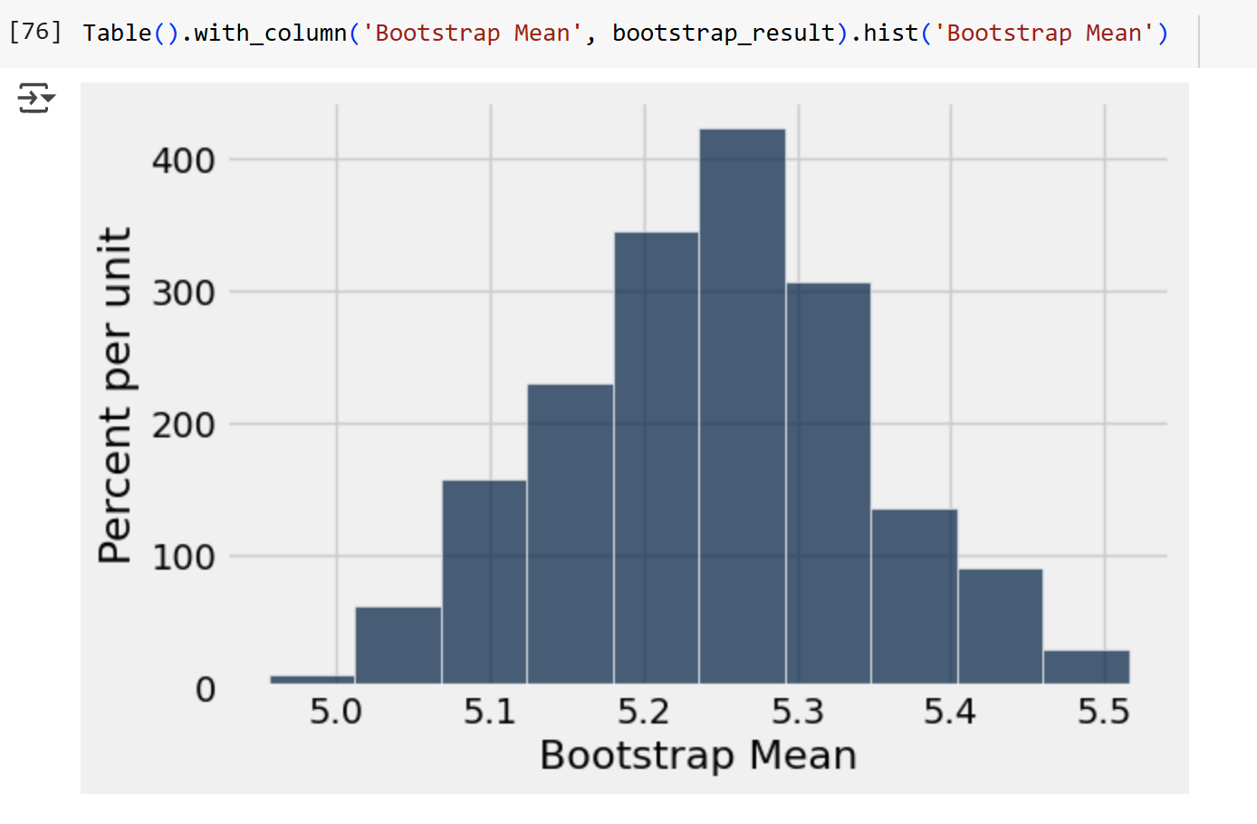
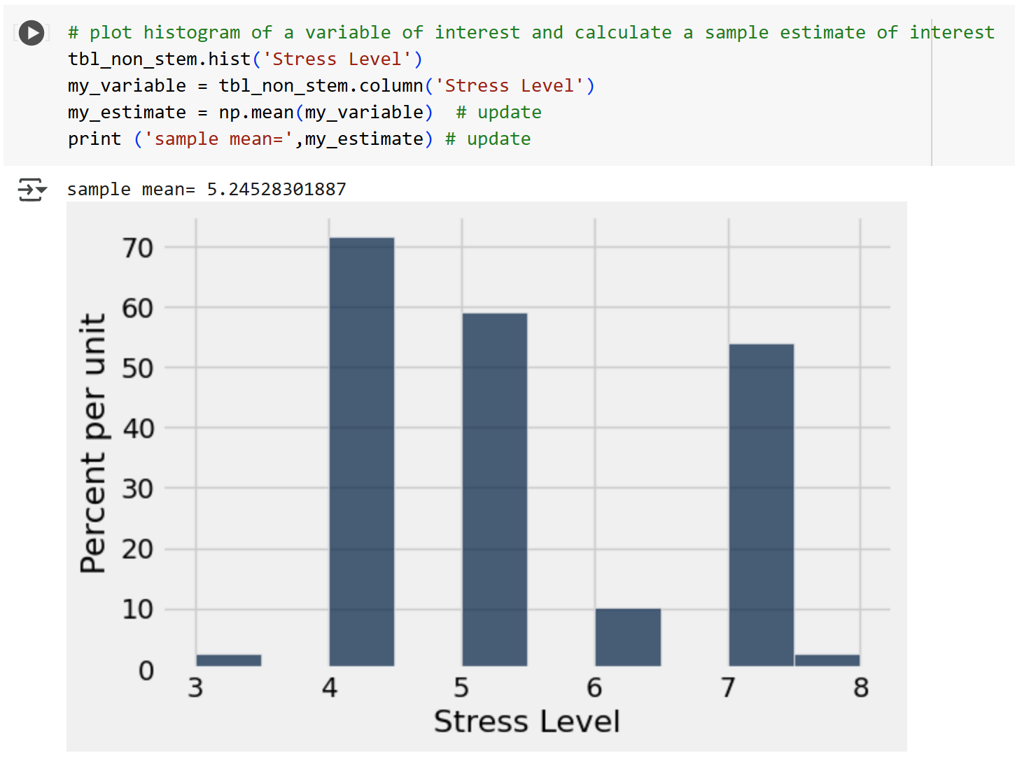
Estimation: Non-STEM Stress Levels
By Carlyn Mangana
I am interested to know if STEM fields have high stress levels compared to Non-STEM
I plan to analyze Stress Levels which describe the average stress levels each person experiences on a scale from 1 being not stressed at all to 10 being very stressed.
My parameter of interest is Mean
95% Confidence Interval of Sample Mean
(5.05, 5.43) meaning that Non-STEM fields are estimated to face average stress levels
95% Confidence Interval of Sample Mean
(5.05, 5.44)
Conclusion: After analysing the data, average stress levels are between 5-6, meaning that most are stressed but not too stressed. Overall, both STEM and Non-STEM stress levels are similar to each other despite have differing graphs.

Slide 16
Progress
By Brittany Huynh and Car Mangana
This week, Car and Brittany answered the following curious questions:
Any correlation between age and stress levels?
What are engineers’ lifestyles like?
Does Gender impact all Job Fields?
Brittany didn’t face many major obstacles, but she struggled to come up with new questions to answer.
Car also didn't face any major obstacles, however, she struggled to do the estimation on her own as it’s a new skill she had just learned.
Carlyn and Brittany both contributed to the project this week. They filled out the spreadsheet and put their names on the slides that they covered in this update.
As for next week, the plan is to:
Start working on the Final Deliverable (Brainstorming, outlining, drafting, etc.)
Create the presentation or video

Slide 17
Feedback
By Carlyn Mangana
The feedback we received was really helpful in teaching us how to read our data better. We also were able to take the feedback we were told and generate better insights using the data we’ve already collected. With the new methods we’ve learned like permutation and estimation, we were able to learn new things about our data set. We’d love to hear what data we should reduce down in order to make our final project look more put together.

Slide 18
Mini Update #3
By Brittany Huynh and Carlyn Mangana
04/20/2025

Slide 19
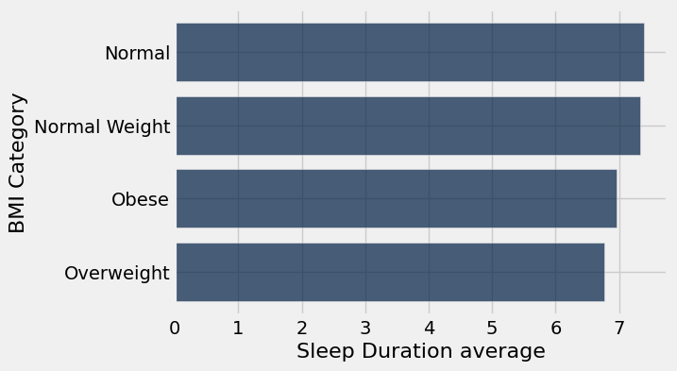
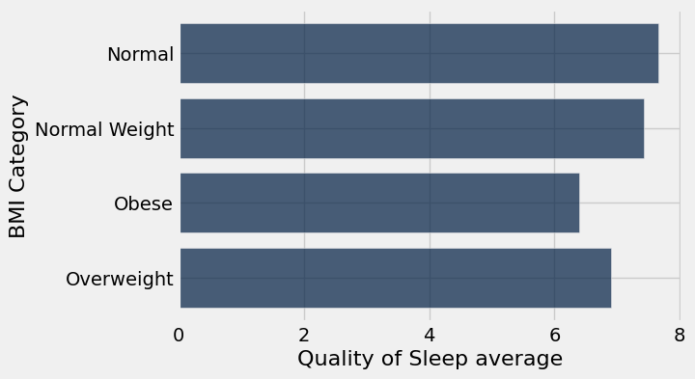
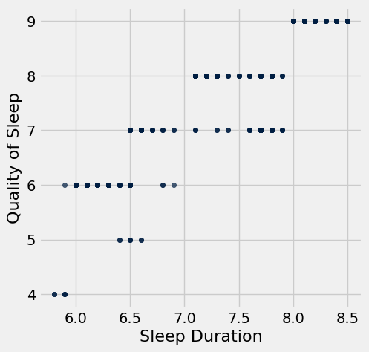
Data Insight: Overweight and Obese people sleep less and get poorer quality sleep than people with Normal weight.
By Brittany Huynh
BMI Category | count
Normal | 195
Normal Weight | 21
Obese | 10
Overweight | 148
The two bar charts show the relationship between BMI category, Sleep Duration average and Quality of Sleep average. The scatter plot shows the relationship between Sleep Duration and Quality of Sleep – the pattern reveals that longer Sleep Duration is linked to higher Quality of Sleep score. The bar charts show that on average, people in the Overweight and Obese BMI category have lower sleep duration and poorer quality of sleep than those in the Normal weight BMI category. This article written by bariatric surgeon, Muhammad Ghanem, claims that poor sleep quality slows metabolism and increases appetite and cravings for junk food. The bar charts reflect the statement that sleep is very important, especially when it comes to weight management. This finding makes me wonder whether there is a correlation between occupation and sleep quality.

Slide 20
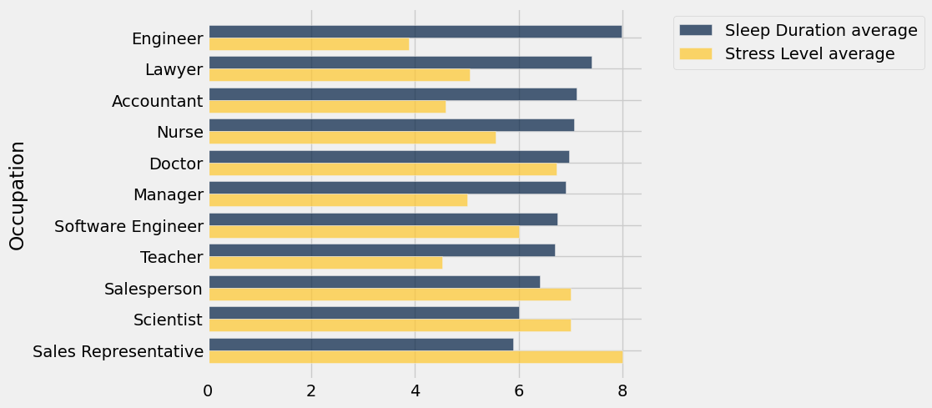
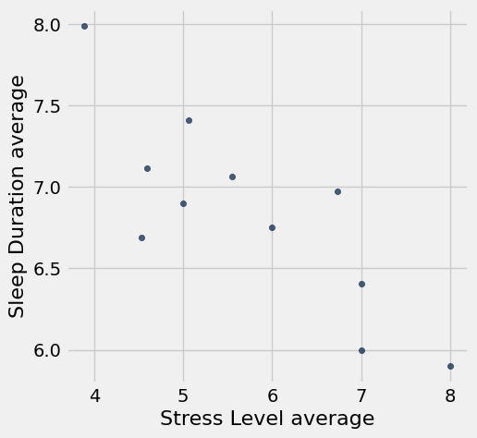
Data Insight: Engineers Sleep the Most, Sales Representatives Sleep the Least – Stress Levels Reflect Sleep Durations.
By Brittany Huynh
This overlaid bar chart shows each occupation’s Sleep Duration average vs. Stress Level average. The data reveals that the occupations with higher sleep durations tend to be less stressed than those with lower sleep durations. The data is making me reconsider my major, maybe I should switch to engineering 😆.

Slide 21
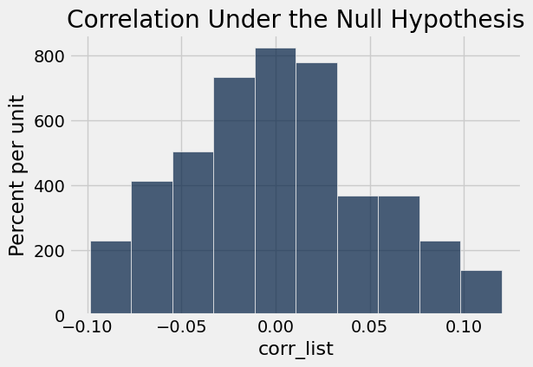
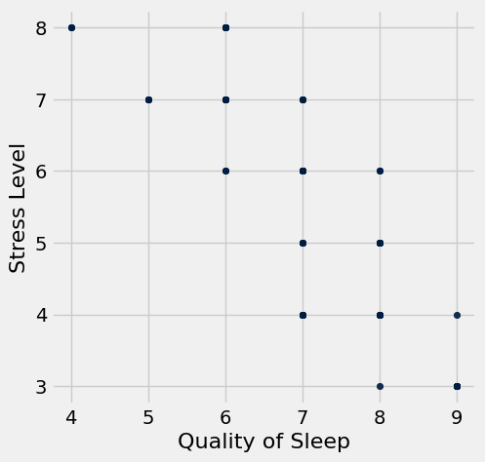
Permutation Test: Quality of Sleep vs. Stress Level
By Brittany Huynh
Observed correlation: -0.898752031004
p-value<0.001
-0.898752031004
Conclusion:
Layman’s version: there is strong evidence supporting the claim that higher sleep quality leads to lower stress levels.
Scientific version: assuming null hypothesis that there is no relationship between stress level and quality of sleep, the chance of seeing a difference at -0.899 or larger is less than 0.001. We reject the null hypothesis at a significance level of 0.001
H0: there is no association between Stress Level and Quality of Sleep
H1: Higher sleep quality leads to lower stress levels

Slide 22
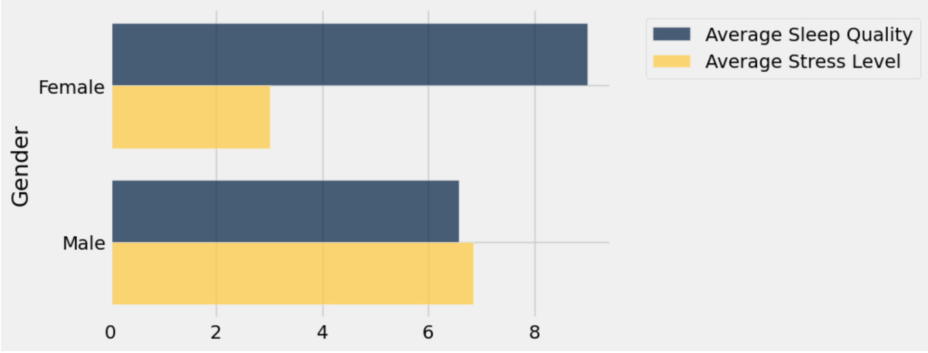
Data Insights
By Carlyn Mangana
This graph shows the average stress level and sleep quality for both female doctors and male doctors indicating that female doctors sleep better than male doctors but have more stress on them. This made me question why this was and a part of me was considering that it could be because within the data table there were far more male doctors than female doctors, however, I wanted to dig deeper and get more insightful answers.

Slide 23
Data Insights
By Carlyn Mangana
This article that I found explained that female doctors have a higher workload compared to male doctors but also receive fewer resources and less control over their workload and schedules. It also reported that women lack in leadership roles and face a compensation disparity which could explain why there were fewer female doctors than male doctors. There are also less rate of career advancements for them and this may cause lower self-compassion and higher stress levels. This ties into my theory that the reason there was less female doctors than male doctors within the data was because of there being gender inequality within the work field, causing it to impact the two differing genders differently. This caused me to ask another curious question,
Does this impact the doctor field or does this result happen in all job fields?
Source: Gender Differences in Physician Burnout: Driving Factors and Potential Solutions

Slide 24
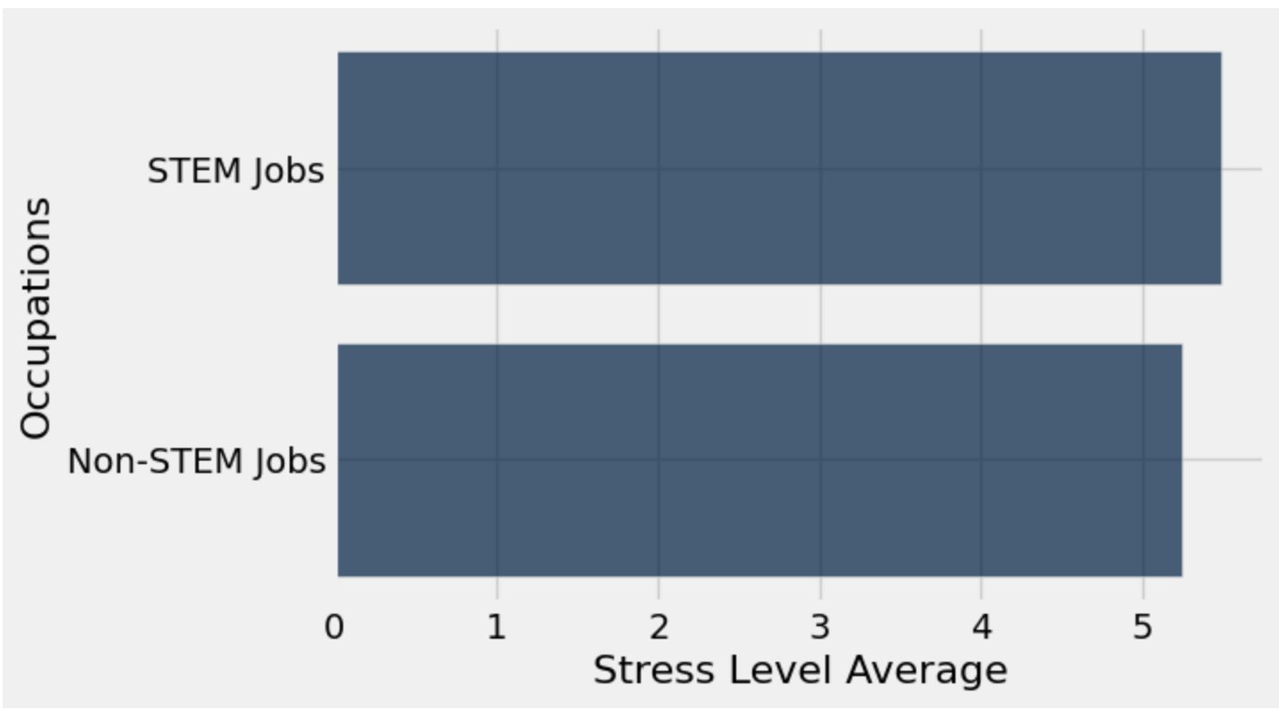
Data Insights
By Carlyn Mangana
This graph shows the difference between those with STEM jobs as well as those in non-STEM job fields. The STEM jobs are based off of the table so they include those who are Software Engineers, Nurses, Doctors, Scientists, and Engineers. The non-STEM jobs are those who are anything outside of those fields in the data table. According to the data, it seems that for the most part they have similar stress levels as I took the average stress level of both those who are in non-STEM and those who are in STEM. This could be due to the fact that despite Lawyer being a non-STEM job, it still has those in the profession working 24/7 on cases and being stressed. This would be something we would take into account when making our final research insights.

Slide 25
Progress
By Brittany Huynh and Car Mangana
This week, Car and Brittany answered the following curious questions from the previous Mini-Update #1:
Is there any correlation between sleep and BMI category? (Plus permutation test)
Does gender impact the doctor lifestyle?
How do the stress levels compare between STEM jobs and those who are not?
Brittany came up with another curious question:
Occupation vs. sleep, any patterns or trends?
Brittany didn’t have any major obstacles this week. Brittany used previous labs and class slides to help her write code. Car also didn’t have any major obstacles and used previous code from labs and google to help further her research.
Carlyn and Brittany both contributed to the project this week. They filled out the spreadsheet and put their names on the slides that they covered in this update.
As for next week, the plan is to:
Answer 2-3 more curious questions
Come up with new questions and insights
Start working on the Final Deliverable (Brainstorming, outlining, drafting, etc.)

Slide 26
Feedback
By Carlyn Mangana
The feedback that we received was to have 2-3 data insights per week, therefore we each did about 2-3 insights to further our research. We also worked on providing more questions within our research so that we can keep branching out further than the data table. We would love to learn more about how to further use our data to create more important insights and questions that can aid our data story in the future! We would also love to learn more methods to get the most out of our data.

Slide 27
Mini Update #2
By Brittany Huynh and Carlyn Mangana
04/13/2025

Slide 28
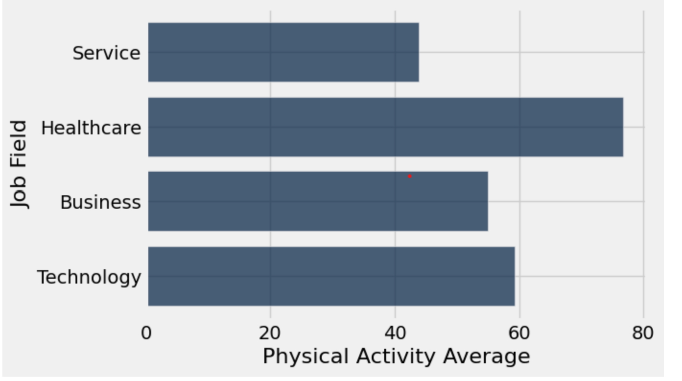
Data Insights
By Carlyn Mangana
This graph shows the various job fields within the data table and how the average physical activity of each job field. The physical activity is on a scale of 0-100, 0 being no physical activity and 100 being very active. Based off of the data results, it seems that healthcare workers have the highest physical activity average. This could be due to the fact that doctors and nurses are always on their feet running around hospitals to tend to those in need. It seems that service workers are the lowest in physical activity average it could indicate that sales representatives these days usually work from home to raise their sales, meaning they don’t need to walk around as much.

Slide 29
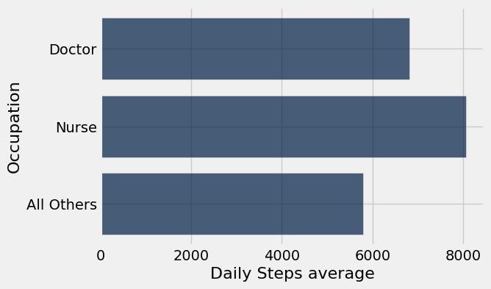
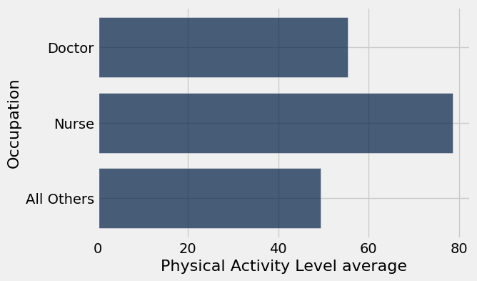
Data Insight: Doctors and Nurses are more physically active than all other occupations on average.
By Brittany Huynh
These bar graphs show the Daily Steps average and Physical Activity Level average of Doctors, Nurses, and all other occupations. These graphs are used to answer my curious question, “Are doctors more physically active than non-doctors?” This insight is similar to Car’s insight on the previous slide. The data shows that both doctors and nurses are more physically active than all other occupations in the dataset, including workers in sales, engineering, education, and more. It’s a well-known fact that moderate amounts of daily physical activity improve well-being, boost heart health, and help maintain a healthy weight. However, this article claims that healthcare workers experienced significant burnout and stress, especially during the height of the COVID-19 pandemic. This leads to me to pose another question, how do the stress levels of doctors and nurses compare to all other occupations in this dataset?

Slide 30
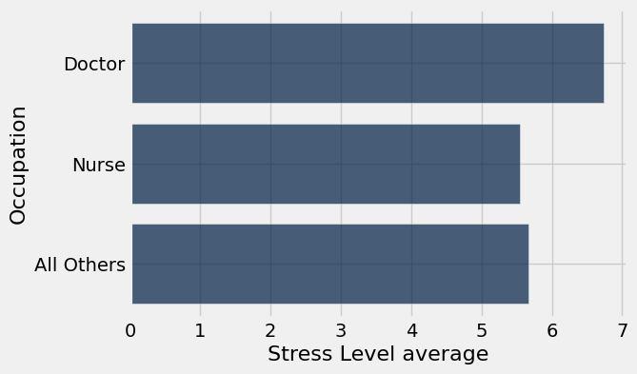
Data Insight: Being a doctor is the most stressful occupation (according to this dataset).
By Brittany Huynh
This graph shows that doctors experienced the highest Stress Level on average compared to nurses and all other occupations. This insight proves the claim from the article in the previous slide that says healthcare workers experience burnout and stress. Doctors’ stress is likely due to physical demands of the job, such as excessive workloads. Doctors are paid extremely well, but does the high salary make up for the stressful nature of the job? Although doctors experience the most stress, nurses’ average stress levels are lower than all other occupations combined.

Slide 31
Progress
By Brittany Huynh
This week, Car and I answered the following curious questions from the previous Mini-Update #1:
How do differing job fields impact physical activity levels?
Are doctors more physically active than non-doctors?
I came up with another curious question:
How do the stress levels of doctors and nurses compare to all other occupations?
As for obstacles, I had trouble figuring out some code, but I contacted Carl on Discord for help. Some other resources I used include the textbook, AI, and previous labs and homeworks.
Carlyn and I both contributed to the project this week. We filled out the spreadsheet and put our names on the slides that we covered in this update.
As for next week, our plan is to:
Answer 2-3 more curious questions
Ask professor or TA’s in class for suggestions on how to come up with more creative ways to analyze the dataset using different types of graphs (we only used bar charts this week, maybe we should try other plots in the future?)
Come up with new questions and insights

Slide 32
Feedback
By Carlyn Mangana
The feedback that we received was that we were missing our data profile so we addressed it by adding a data profile to the mini update #1. The feedback did seem useful as it helped us evaluate our data better and made us realize that we should be cleaning and filtering like values and those that are null. Additional feedback that could benefit us is how to expand upon our questions as well as simplify our methods to extract this information. It would also be helpful if we could get some guidance on how to create more questions to get more information out of our data.

Slide 33
Mini Update #1
By Brittany Huynh and Carlyn Mangana

Slide 34
Introduction
People choose their careers based off of many factors such as salary, hours, and even the reputation of certain companies. However, a big factor that people choose their careers on is lifestyle as it can impact their performance and passion for their career. Lifestyles can be impacted by the type of job a person has. Having a heavy work flow can lead to getting less sleep and sleeping worse. Being too busy with a job and not having time to get physical activity can lead to an unhealthy lifestyle which may deter people from certain jobs that are too demanding.

Slide 35
Mini Update #1 - Data Profile
This dataset has 374 rows and 13 columns
Column Name | Has missing value? | Data Type(Discrete or numeric or free text) | Useful? | Need cleaning or processing?
Person ID | No | Numeric | No | No
Gender | No | String | Yes | No
Age | No | Numeric | Yes | No
Occupation | No | String | Yes | No
Sleep Duration | No | Float | Yes | No
Quality of Sleep | No | Numeric | Yes | No

Slide 36
Column Name | Has missing value? | Data Type(Discrete or numeric or free text) | Useful? | Need cleaning or processing?
Physical Activity Level | No | Numeric | Yes | No
Stress Level | No | Numeric | Yes | No
BMI Category | No | String | No | No
Blood Pressure | No | Numeric | No | No

Slide 37
Column Name | Has missing value? | Data Type(Discrete or numeric or free text) | Useful? | Need cleaning or processing?
Heart Rate | No | Numeric | No | No
Daily Steps | No | Numeric | Yes | No
Sleep Disorder | Yes | String | Yes | Yes (to remove missing values)

Slide 38
Curious Questions
How do differing job fields impact physical activity levels?
Does gender impact the doctor lifestyle?
How do the stress levels compare between STEM jobs and those who are not?
Are doctors more physically active than non-doctors?
Which occupation(s) have the highest Daily Step count?
Does Quality of Sleep correlate with BMI Category?

Slide 39
Audience and Communication Goal
Audience: Young adults who are interested in learning more about lifestyle habits (physical activity and sleep behaviors) and correlations between occupation, stress level, and sleep quality.
Communication Goal: Broaden perspective on career paths vs. lifestyle choices, improve understanding of stress levels, activity levels, sleep levels, weight and their relationship with occupation

Slide 40
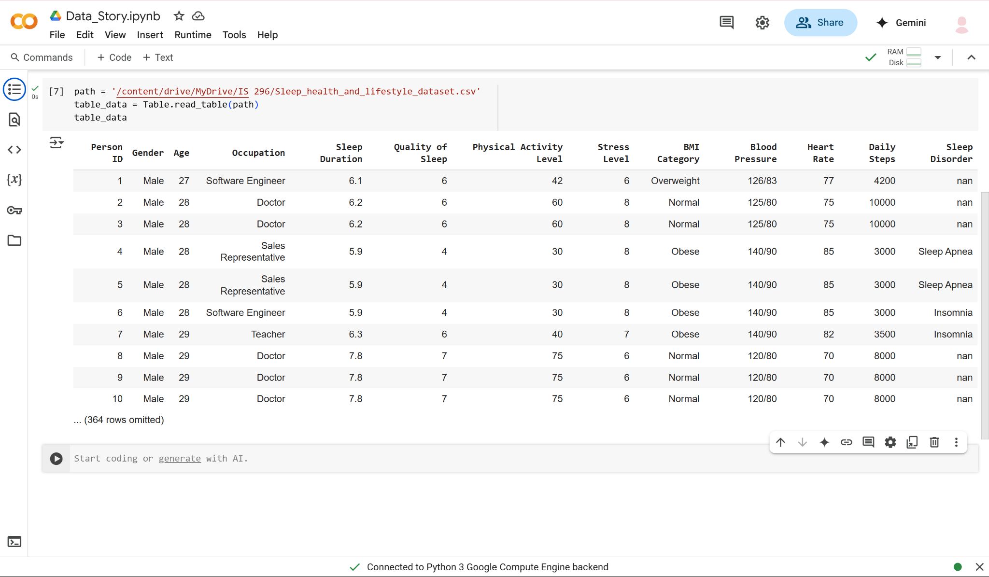
We created a google colab so that we could both work on the data and figure out what questions we wanted to ask based off of the data table.

